Slide 1
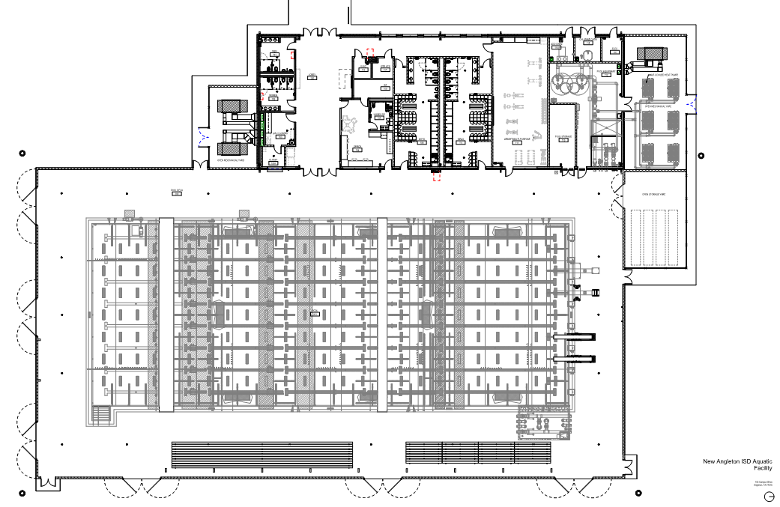

Enter through this door
LOCKER ROOMS
Hospitality
LASA
HCYA
MLP
ANGL
BACT
Coaches Area
Coaches Area
WU / CD
GIRLS’ COMPETITION POOL
BOYS’ COMPETITION POOL
STAF / HUNT / AUAR / LCCS / WECO / TXCI
COMPETITION AREA
STTH
FRSW
AICO
HOCL
BYST
ELCA
SPECTATORS ONLY
GP
NS
SPECTATORS ONLY
FBDU
FBHI

